Slide 1
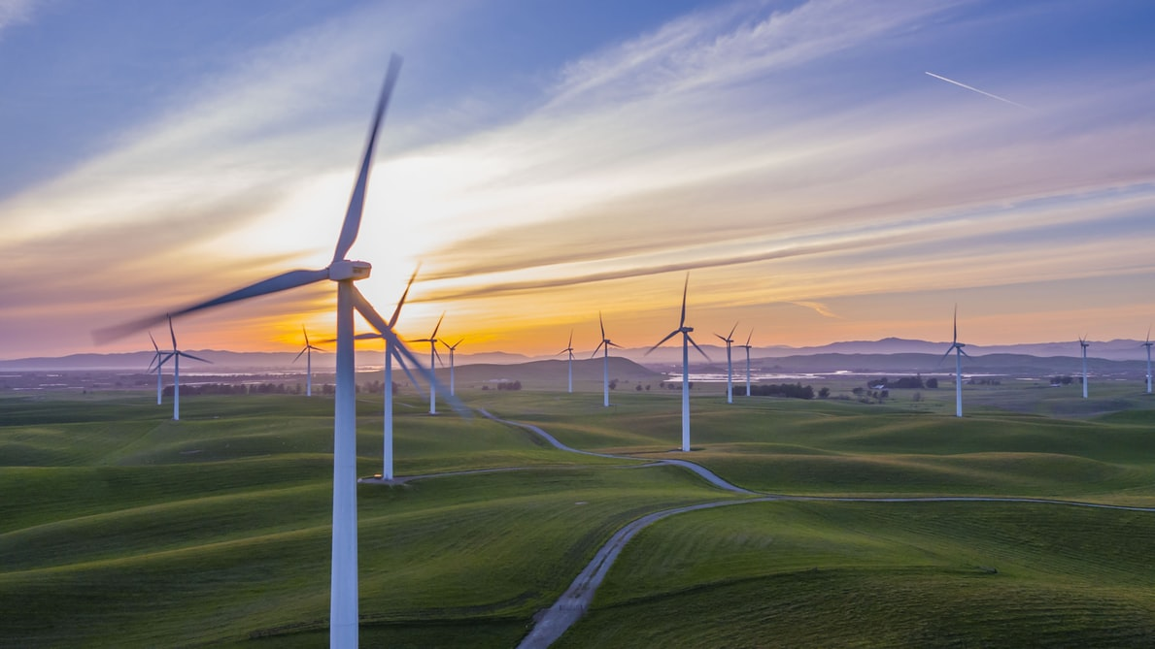
Predicting Turbine Capacities
Alper Çakır

Slide 2




INTRODUCTION
Objectives: Measuring turbine characteristics how much effects on the turbine capacity. In this context, the question that I asked is ‘How should I design my turbine?’ .
Solution: To answer this question I examined a dataset(with 63003 rows) which includes U.S Wind Turbines from 45 state & 542 counties. I got my dataset from usgs.gov, latest update was from 09.01.2020.

Slide 3
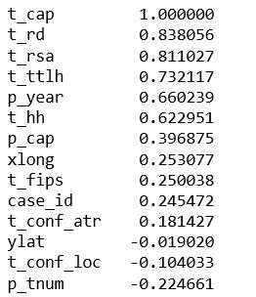
Data & Methodology
How many features do I have ?
Turbine Characteristics: turbine hub height, turbine rotor diameter, turbine rotor swept area, turbine total height.
Location Infos: state, county, fips, latitude, and longitude.

Slide 4
Data & Methodology
Firstly, basic data analysis on the dataframe
Statistical Modeling with OLS, with turbine characteristics
Adding new features to improve model’s estimation
Conclusion & Future Works
Modeling with Sklearn library: Linear Reg., Lasso, Ridge, and CV

Slide 5
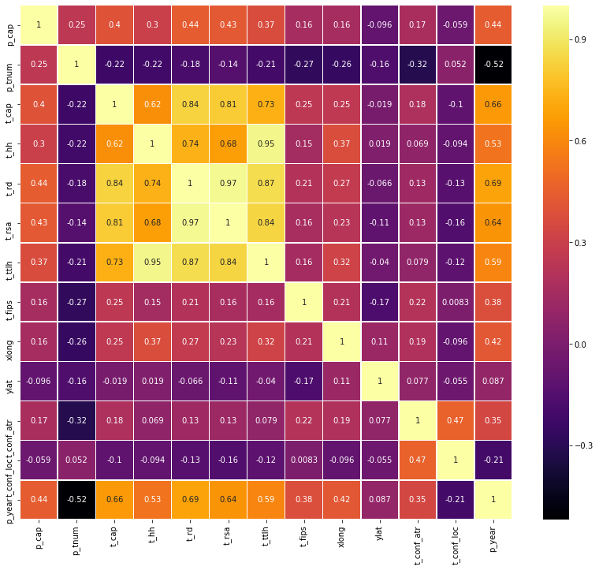
Correlatıon Heatmap

Slide 6
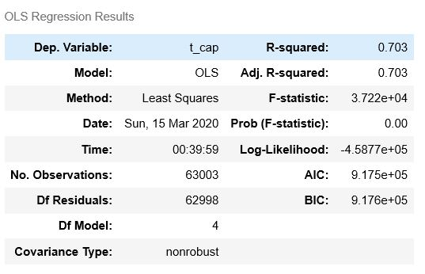
M.l. Model Steps
Basic StatsModel- with added features R-suared become 0.719
Statistical Modeling with OLS
Simple Validation-Linear Regression & Regularization
Cross Validation-Linear Regression & Regularization
Comparison of Models

Slide 7
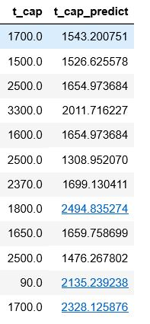
Conclusıons
Turbine capacities and predictions
First R-squared that I got was 0.703, after added features it become 0.719 in Statistical model.
Linear, Ridge, and Lasso scores are approximately the same in simple validation and also cross-validation.
Max score that I achieved is 0.72, this result is from linear regression in cross-validation.
Turbine characteristics and location infos aren’t enough to make a proper estimation and build a robust regression model at least with the features I have, so I need expanse my dataframe.

Slide 8
Future Works
As I mentioned in Results, this dataframes doesn’t include geographical features such as wind flow per seasons, etc. Therefore, I need to expand the data set in this direction.
Addition of new rows from different countries.
After build a robust model, prediction of Project capacity and how many turbines that i need, and also calculation of efficiency.
Prediction of the best locations to build wind turbine farm.
Readjustment of hyperparameters.
Real-time regression modeling with augmented reality.

Slide 9
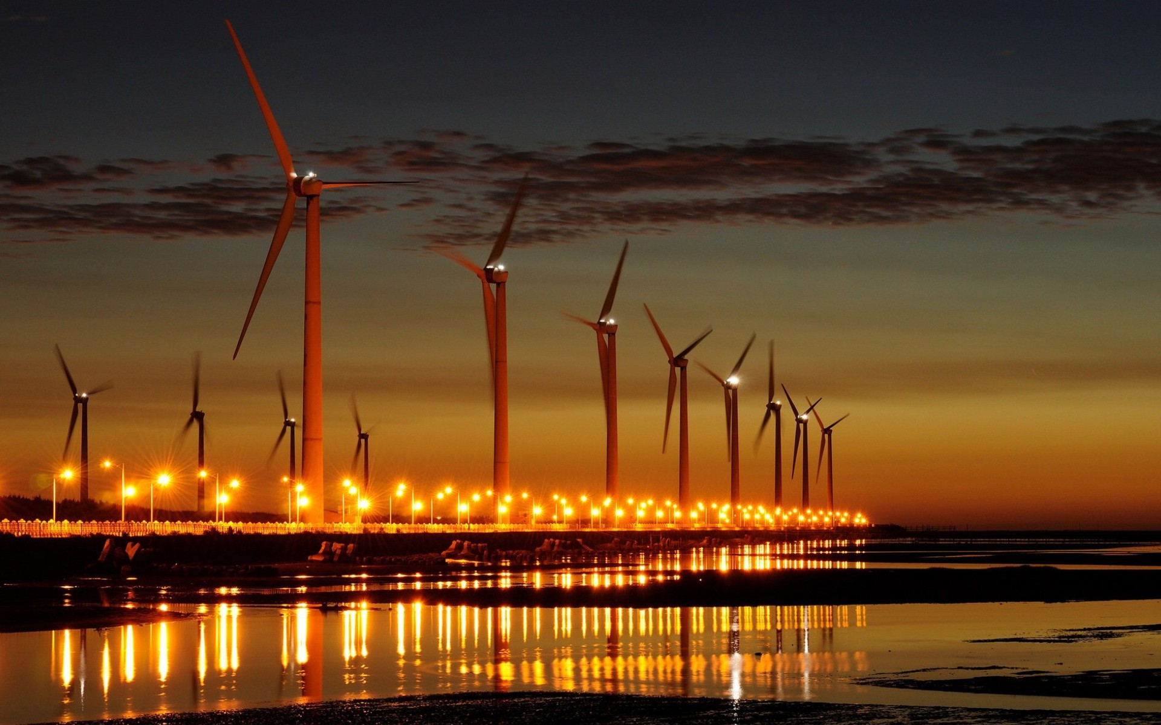
THANK YOU

